Slide 1


Project - II (3360707)
GST BILL GENERATOR
Prepared By:
Shah Harsh (196620307059)
Parekh Udit(196620307043)
Diploma Computer Engineering
Darshan Institute of Engg. & Tech. for Diploma Studies, Rajkot.
Guided By:
Prof. Bhavesh Chhatrala
Computer Engineering Dept.,
Darshan Institute of Engg. & Tech. for Diploma Studies, Rajkot.

Slide 2
ABSTRACT
When we want to generate the bill for the purchased products, it takes lots of time to calculate bill amount and there may chances of mistake in calculation. In case of mistake in calculate, it leads to wastage of paper and time. So, we have developed Android Application “GST Bill Generator” will generate the bill in PDF format very easily. In application we have to just add customer details first time, add list of product purchased by the customer and it will generate a bill quickly. This application have functionalities to save generated bill for future use, user can view previously purchased product details of the customer etc. So, it saves our precious time and environment.

Slide 3
PROBLEM SUMMARY
Problem Identification
When we want to generate the bill for the purchased products, it takes lots of time to calculate bill amount and there may chances of mistake in calculation. In case of mistake in calculate, it leads to wastage of paper and time. It is also difficult to maintain hard copy of the bills for user/shopkeeper.

Slide 4
PROBLEM SUMMARY(conti…)
Problem Solution
The solution for above mentioned problem, we have developed Android Application “GST Bill Generator” will generate the bill in PDF format very easily. In application we have to just add customer details first time, add list of product purchased by the customer and it will generate a bill quickly. This application have functionalities to save generated bill for future use, user can view previously purchased product details of the customer etc. So, it saves our precious time, environment and cost effectively.

Slide 5
DETAIL DESCRIPTION
Customer:
The details of customer have been stored in this module. User can insert detail about their customer such as Customer Name, City and Contact Number etc.
CustomerID :ID of customer
CustomerName :Name of customer
ContactNumber :Contact number of customer
City :City of customer
CreatedDate :Date when customer added

Slide 6
MODULE DESCRIPTION(conti…)
Product :
In this module, the details of product have been stored. User can view product detail like Product Name, GST Percent, Price etc.
ProductID :ID of product
ProductName :Name of product
ProductGSTPercent :GST percent of product
ProductPrice :Price of product
ProductQuantity :Quantity of product

Slide 7
MODULE DESCRIPTION(conti…)
Purchase:
In this module, the details of purchased product have been stored. User can insert and delete purchased product.User can insert product details like Product Name, GST Percent, Purchase Quantity, Total Price etc.
PurchaseID :ID of purchase
ProductID :ID of product
CustomerID :ID of customer
PurchasedQuantity :Quantity of purchase
TotalPrice :Total price of purchase

Slide 8
MODULE DESCRIPTION(conti…)
Bill:
In this module, After purchase products by the customer, Bill will be generated and save all details for future use. Bill contains details like Customer Name, Product Name, Product GST Percent, Purchased Quantity, Total Price of Bill etc.
BillID :ID of Bill
PurchaseID :ID of purchase
CustomerID :ID of customer
TotalBill : Total Bill Amount to be pay
BillDate :Date of bill created
Ispaid :Is bill paid or not

Slide 9
MODULE DESCRIPTION(conti…)
History:
In this module, the past purchase details of the customers will be stored. User can view & download previously generated bill. Bill contains details like Customer Name, Product Name, Product GST Percent, Purchased Quantity, Total Price of Bill etc.
HistoryID :ID of History
CustomerID :ID of customer
PurchaseID :ID of purchase
BillID :ID of BillGenerate

Slide 10
DATA DICTIONARY
INS_CustomerDetail
Field Name | Data Type | Size | Constraint | Reference
CustomerID | integer | 10 | PK | -
CustomerName | varchar | 50 | NOT NULL | -
ContactNumber | varchar | 20 | NOT NULL | -
CreatedDate | datetime | 50 | NOT NULL | -
City | varchar | 30 | NOT NULL | -
Remark | varchar | 100 | - | -

Slide 11
DATA DICTIONARY(conti…)
MST_ProductDetail
Field Name | Data Type | Size | Constraint | Reference
ProductID | integer | 10 | PK | -
ProductName | varchar | 50 | NOT NULL | -
ProductGSTPercent | integer | 10 | NOT NULL | -
ProductPrice | integer | 10 | NOT NULL | -
ProductQuantity | integer | 10 | NOT NULL | -
Remark | varchar | 100 | - | -

Slide 12
DATA DICTIONARY(conti…)
INS_HistoryDetail
Field Name | Data Type | Size | Constraint | Reference
HistoryID | integer | 10 | PK | -
CustomerID | integer | 10 | FK | INS_CustomerDetail
PurchaseID | integer | 10 | FK | INS_PurchaseDetail
BillID | integer | 10 | FK | INS_BillGenerate
Remark | varchar | 100 | - | -

Slide 13
DATA DICTIONARY(conti…)
INS_PurchaseDetail
Field Name | Data Type | Size | Constraint | Reference
PurchaseID | integer | 10 | PK | -
CustomerID | integer | 10 | FK | INS_CustomerDetail
ProductID | integer | 10 | FK | MST_ProductDetail
PurchasedQuantity | integer | 10 | NOT NULL | -
TotalPrice | integer | 10 | NOT NULL | -
Remarks | varchar | 100 | - | -

Slide 14
DATA DICTIONARY(conti…)
TRN_BillGenerate
Field Name | Data Type | Size | Constraint | Reference
BillID | integer | 10 | PK | -
PurchaseID | integer | 10 | FK | INS_PurchaseDetail
CustomerID | integer | 10 | FK | INS_CustomerDetail
TotalBill | integer | 10 | NOT NULL | -
BillDate | datetime | 50 | NOT NULL | -
IsPaid | integer | 10 | NOT NULL | -
Remarks | varchar | 30 | - | -

Slide 15
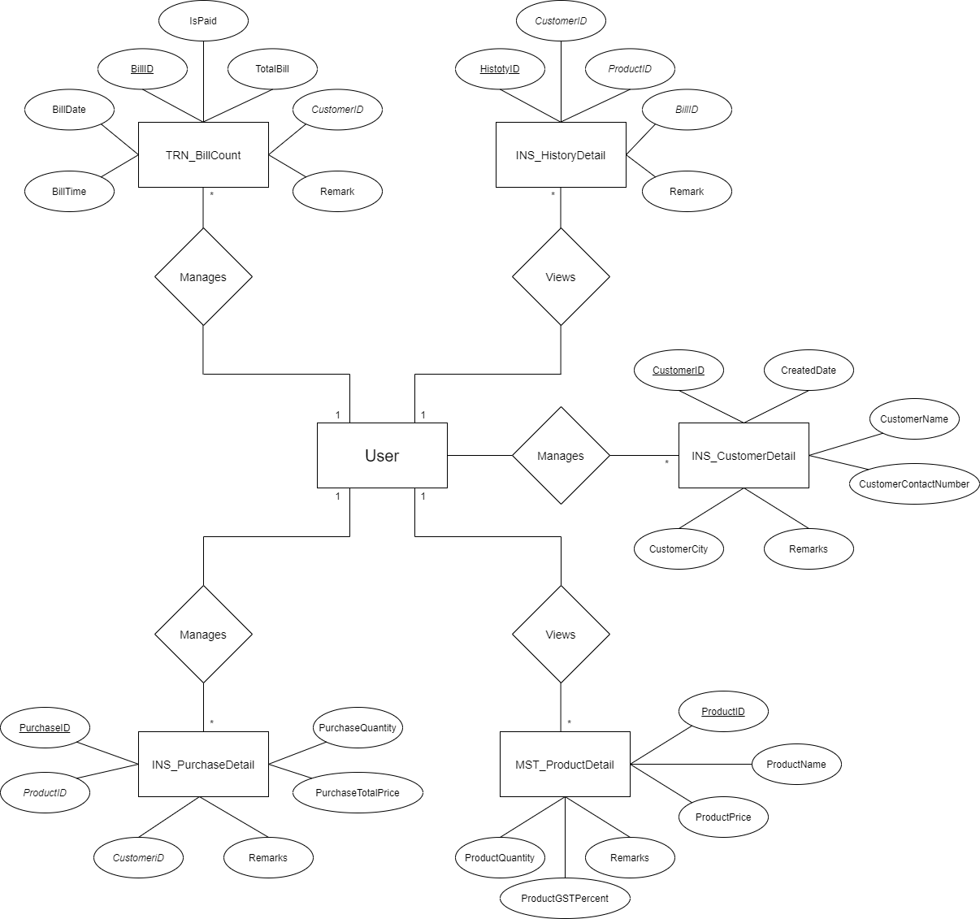
DIAGRAMS
E-R DIAGRAM
Fig 7.1

Slide 16
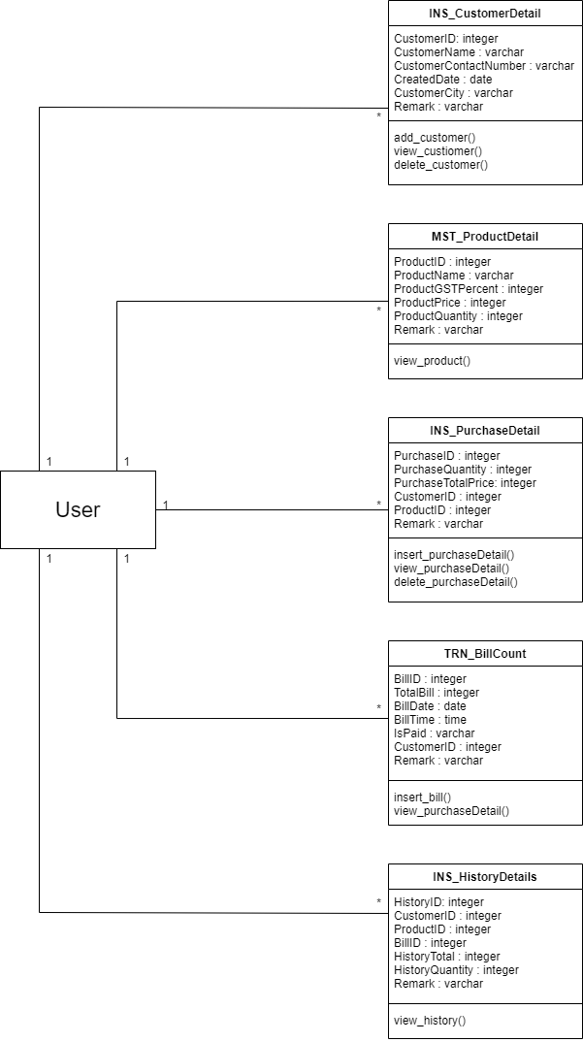
DIAGRAMS(conti…)
CLASS DIAGRAM
Fig 7.2

Slide 17
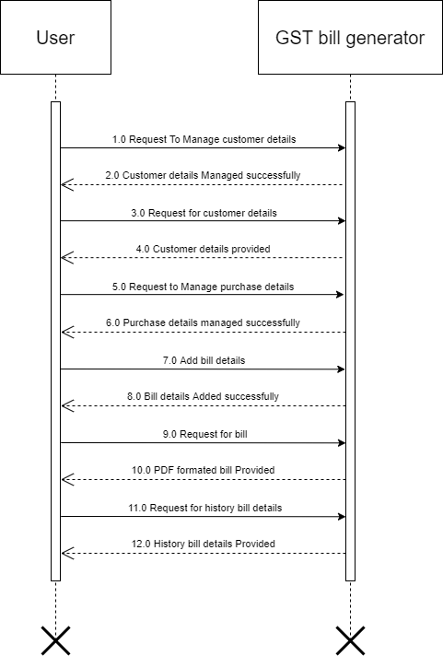
Diagrams (conti…)
SEQUENCE DIAGRAM
Fig 7.3

Slide 18
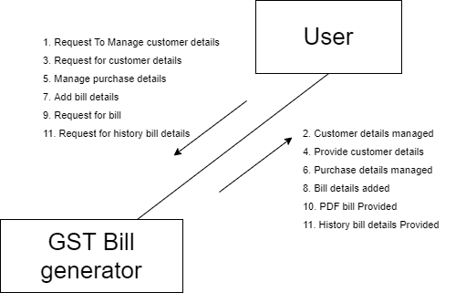
Diagrams (conti…)
COLLABORATION DIAGRAM
Fig 7.4.1

Slide 19
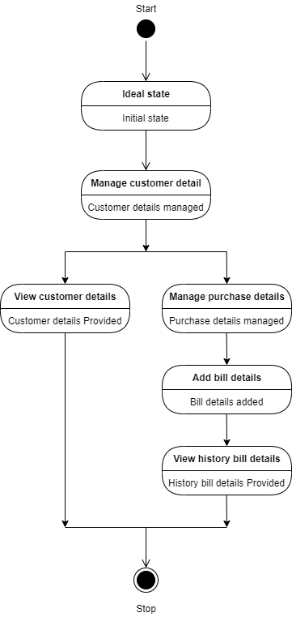
Diagrams (conti…)
STATE DIAGRAM
Fig 7.4.2

Slide 20
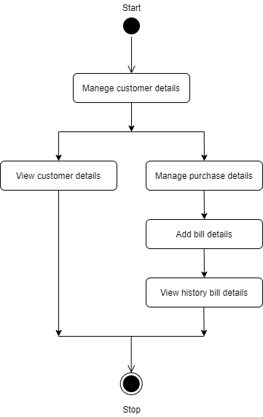
Diagrams (conti…)
ACTIVITY DIAGRAM
Fig 7.5.1

Slide 21
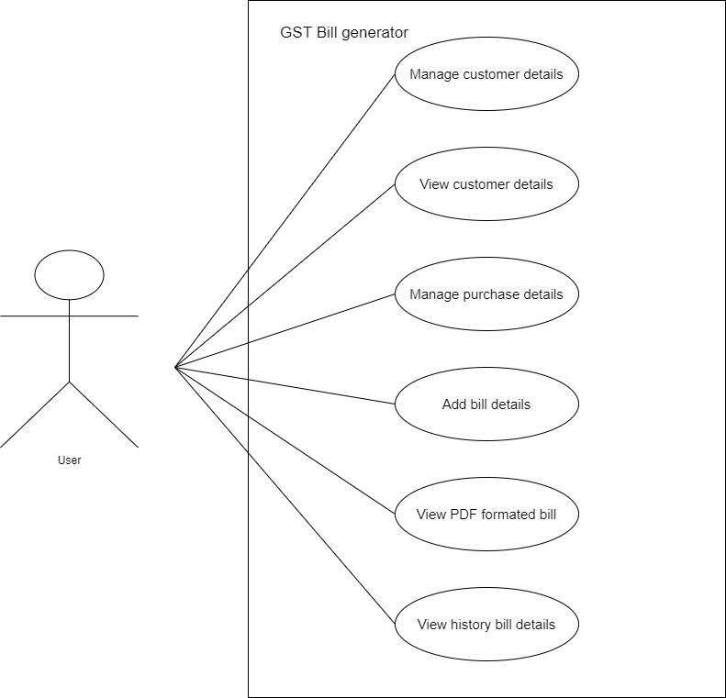
Diagrams (conti…)
USE CASE DIAGRAM
Fig 7.5.2

Slide 22
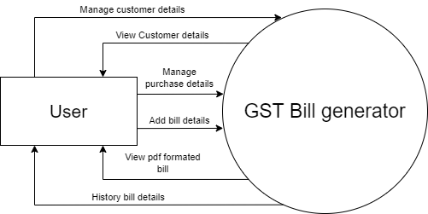
Diagrams (conti…)
DATAFLOW DIAGRAM(LEVEL 0 Admin)
Fig 7.7.1

Slide 23
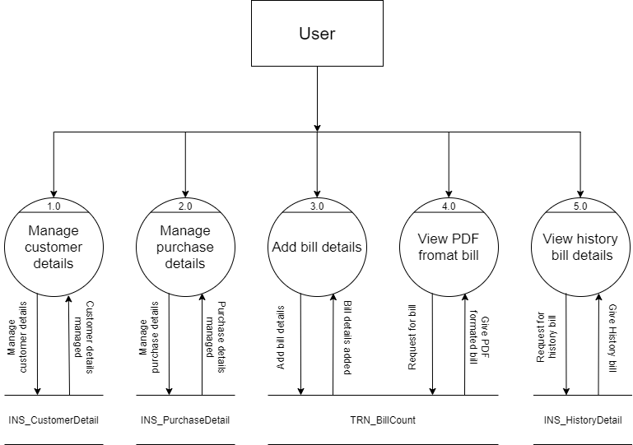
Diagrams (conti…)
DATAFLOW DIAGRAM(LEVEL 1 Admin)
Fig 7.7.2

Slide 24
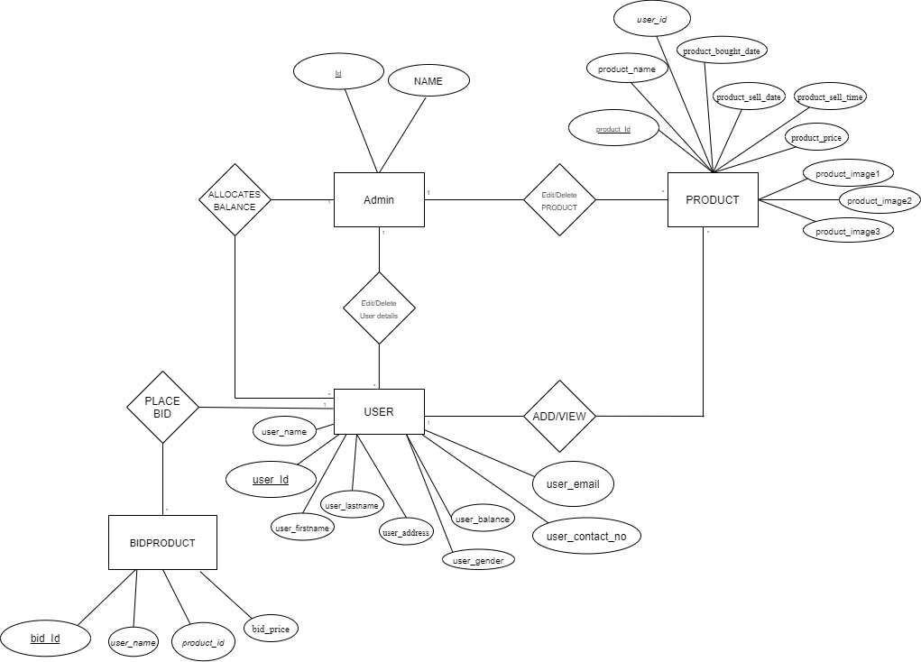
Diagrams (conti…)
E-R DIAGRAM
Fig 7.8

Slide 25
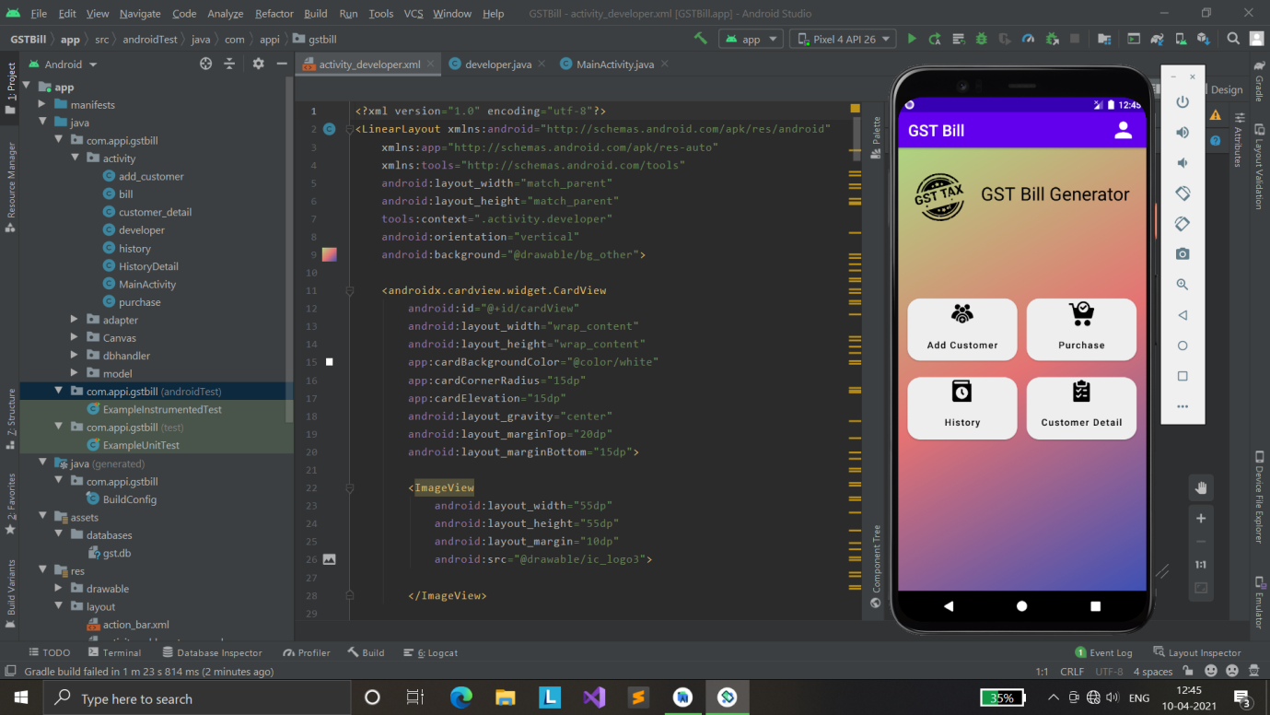
Screenshots
DASHBOARD
Fig 8.1

Slide 26
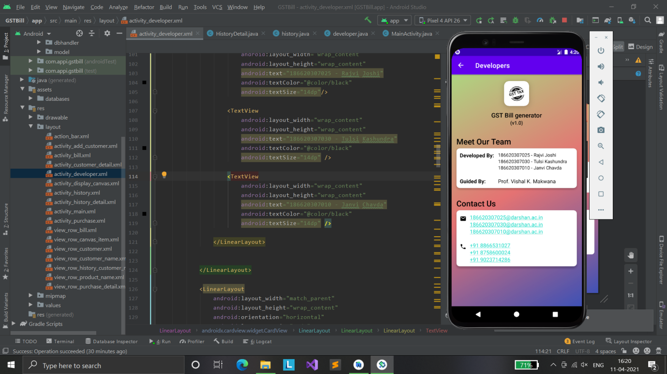
Screenshots (conti…)
DEVELOPER
Fig 8.2

Slide 27
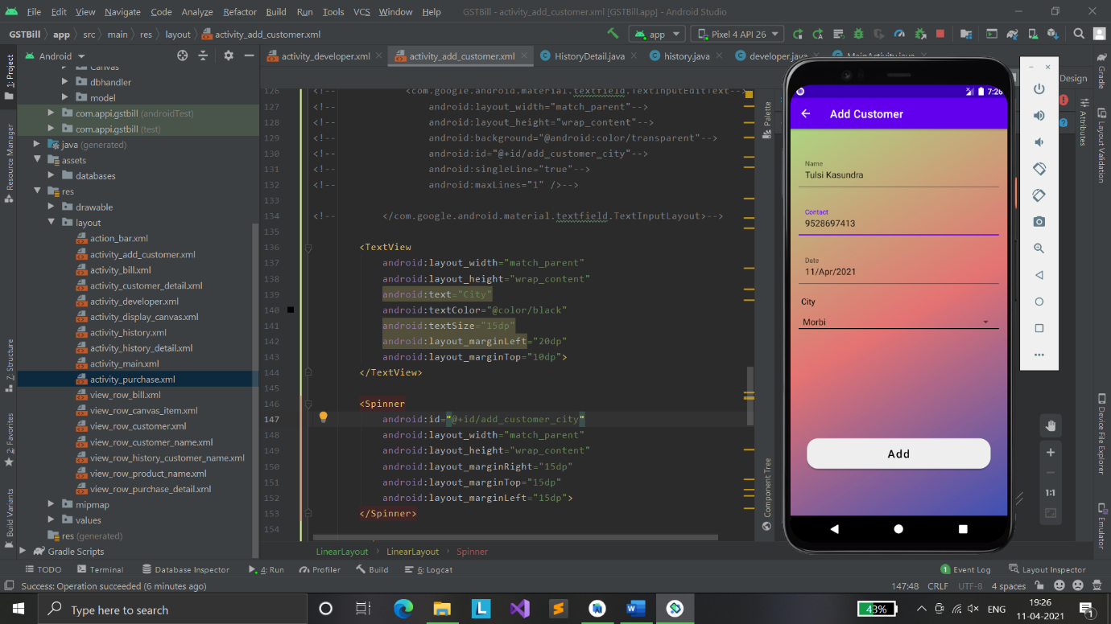
Screenshots (conti…)
ADD CUSTOMER
Fig 8.3

Slide 28
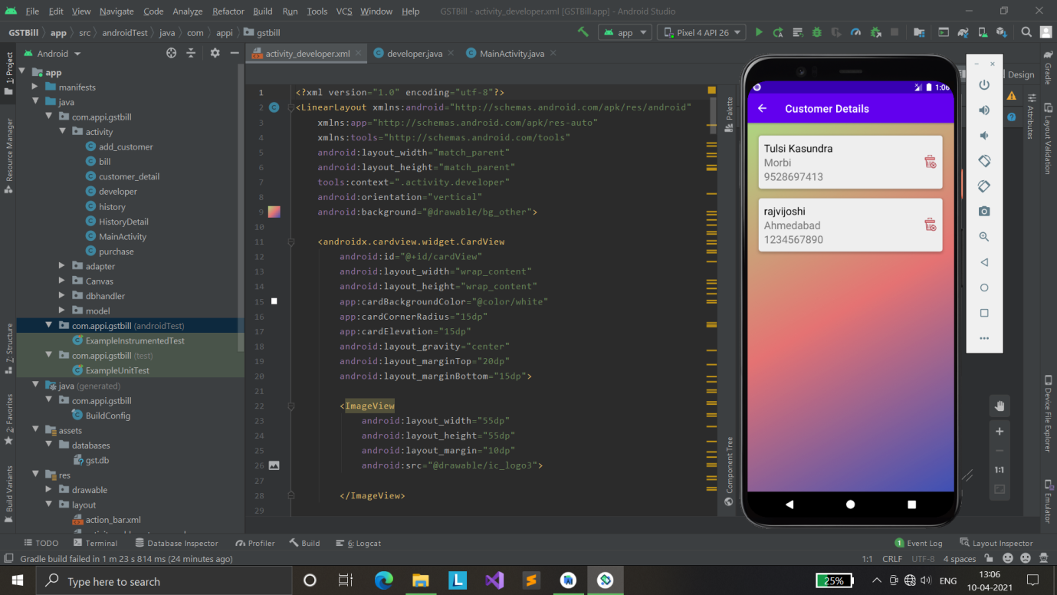
Screenshots (conti…)
CUSTOMER DETAILS
Fig 8.4

Slide 29
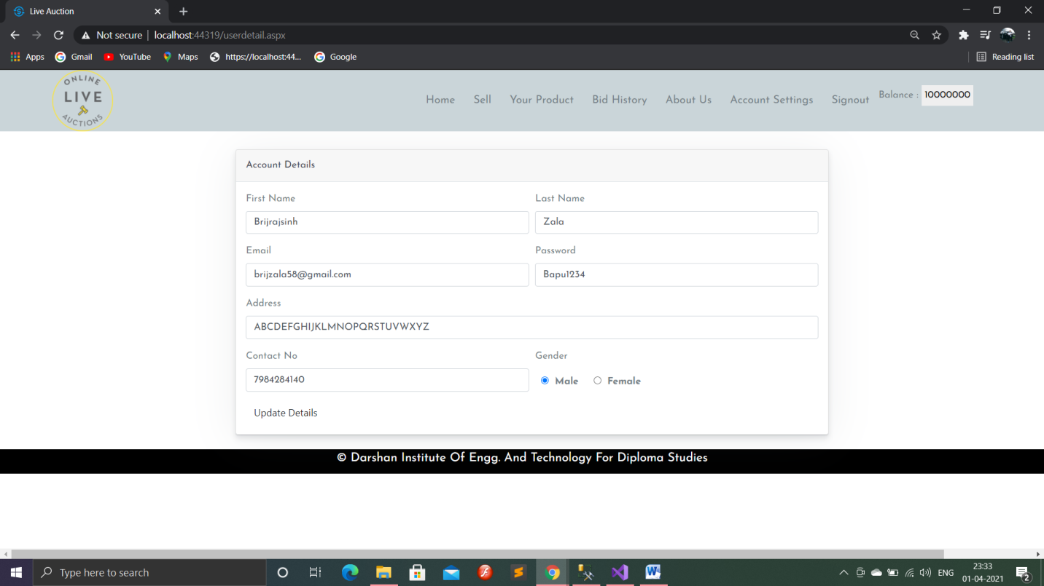
Screenshots (conti…)
Account Setting Page
Fig 8.5

Slide 30
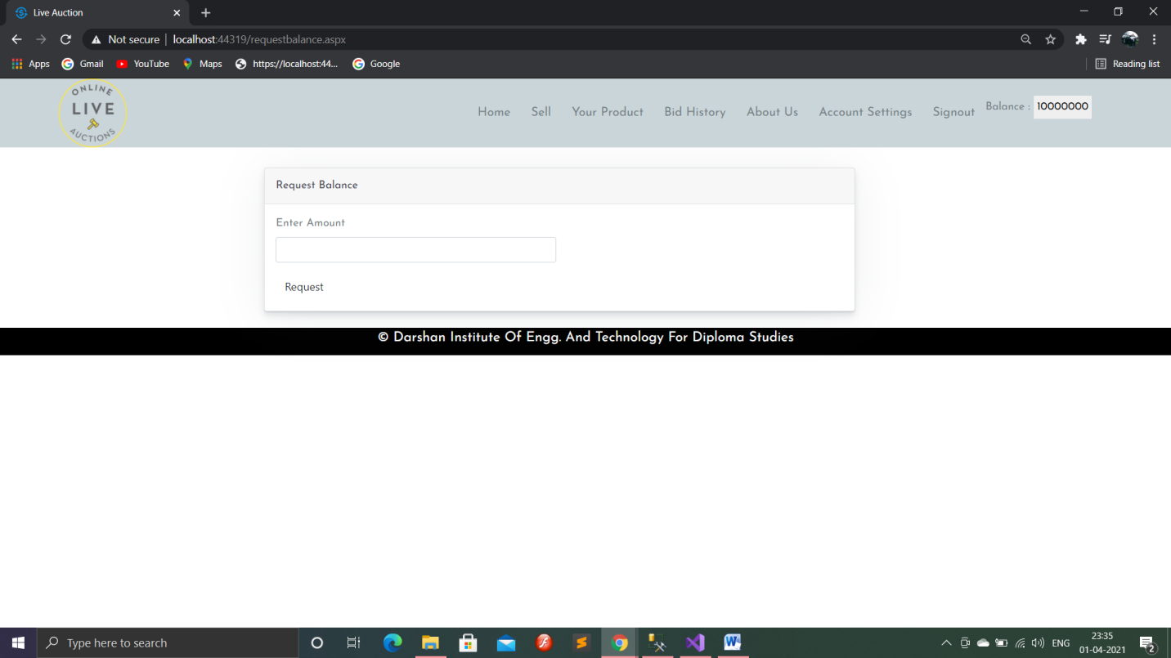
Screenshots (conti…)
Balance Request Page
Fig 8.6

Slide 31
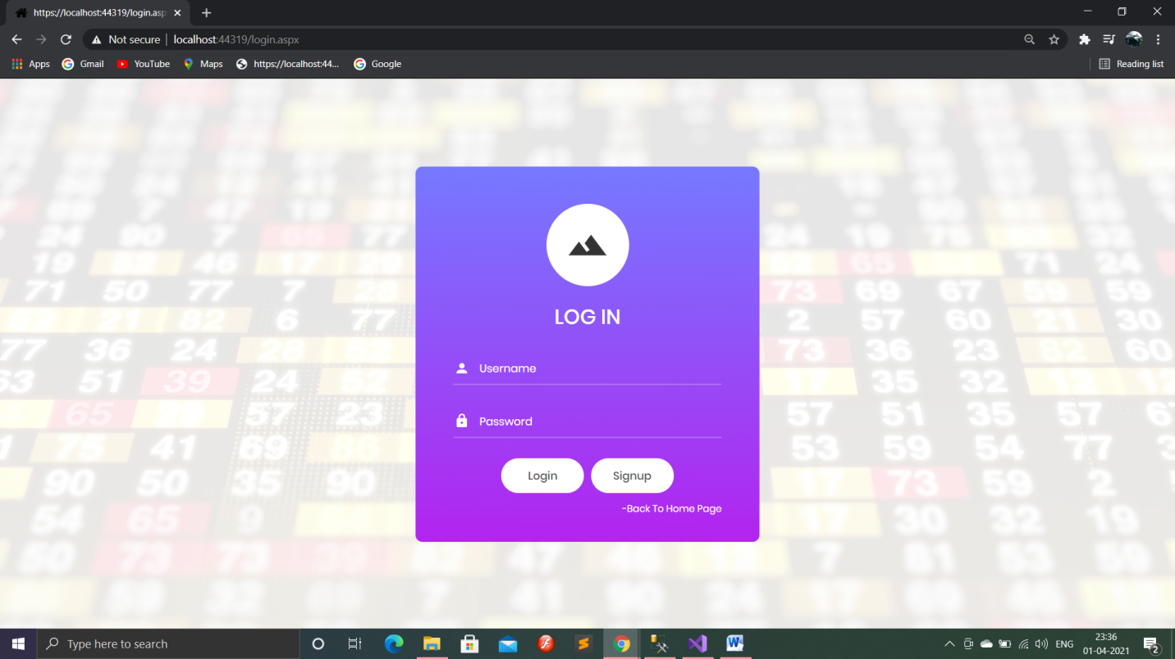
Screenshots (conti…)
Login Page
Fig 8.7

Slide 32
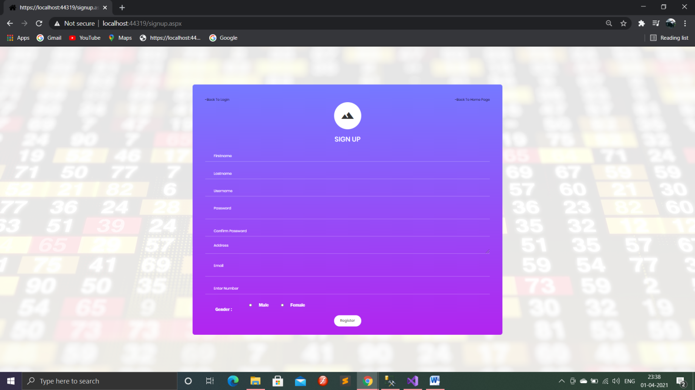
Screenshots (conti…)
Signup Page
Fig 8.8

Slide 33
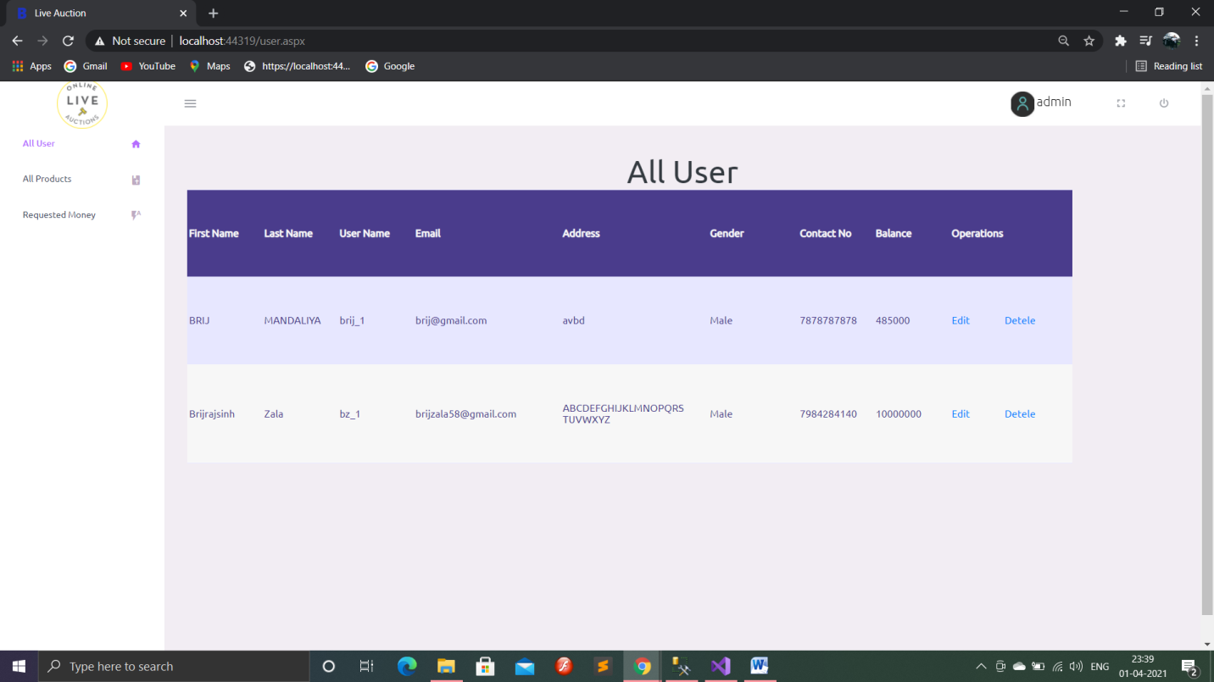
Screenshots (conti…)
All User Page (Admin)
Fig 8.9

Slide 34
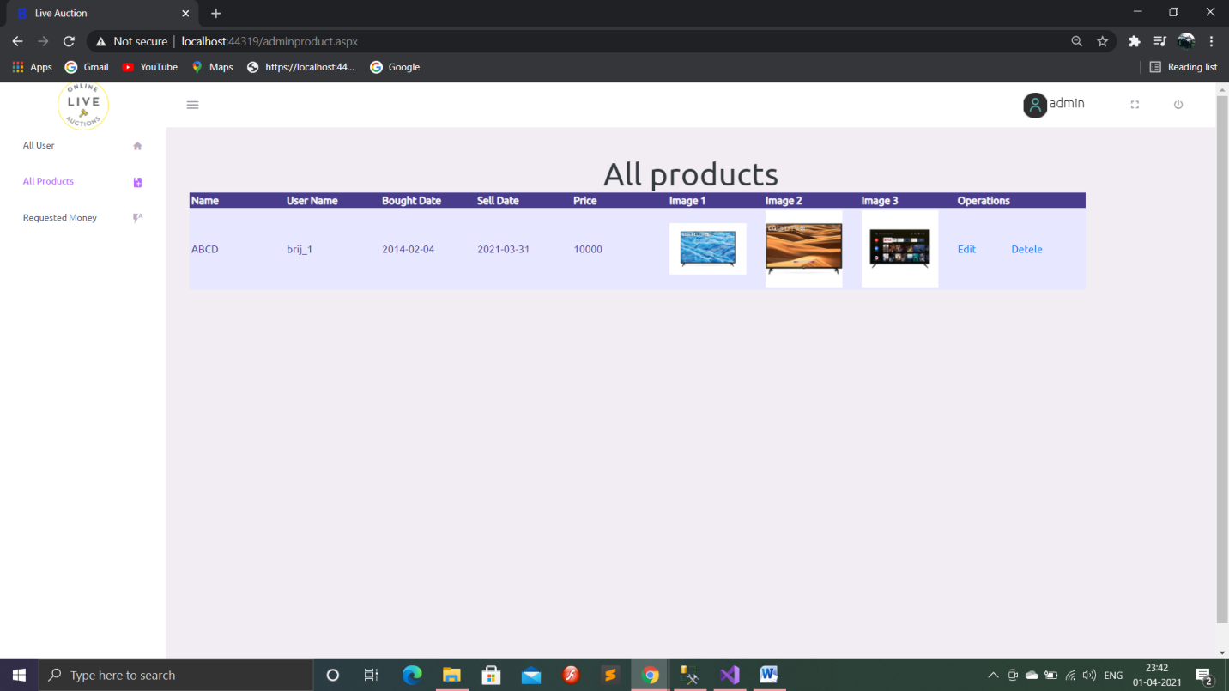
Screenshots (conti…)
All Product Page(Admin)
Fig 8.10

Slide 35
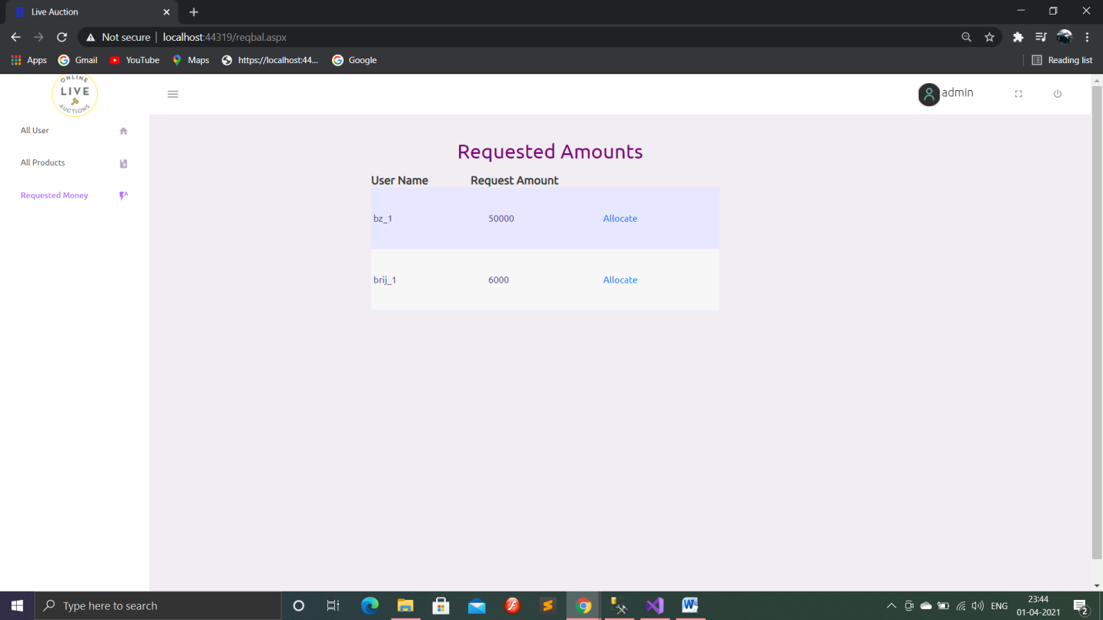
Screenshots (conti…)
Request Balance Page(Admin)
Fig 8.11

Slide 36
Conclusion
Our Web Portal provides facility of bidding from anywhere on any products. Therefore number of customers increases for bidding. Selling of products is easier in e-Auctions because user don’t need to take product to some auction places. He / She can directly place product on web portal with filling up some information of product. Hence, e-Auction are beneficial compared to offline auctions.

Slide 37
Future Enhancement
As we have developed our website for e-auction. There are still many functionality which we will provide in future like Delivery of products at home, various login facilities with google, facebook. Displaying more information of the sellers and bidders, enhancing the website, user can add balance to account through online payment directly, dynamic admin login rather than static login, user can directly add multiple products which are available in account by just selecting them. In future website can provide sorting of products according to the user’s balance or according to user’s interest in products and webiste may provide auto generated receipts after auction of any particular product which is won by the user for safety purpose.We will also provide facility for bidding on various things like properties, homes,etc.

Slide 38
THANK YOU…

